Slide 1
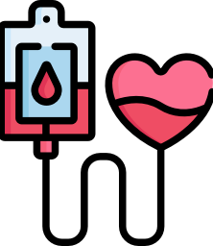
Life Saver A Blood Donor Application
Presented By
Dhanaselvan J U
Jaswath K
Aagesh G

Slide 2
Agenda
Abstract
Data Flow Diagram
Identify Tools
Conculsion
Project modules
Presentation Title

Slide 3

Abstract
Life saver is a web-based application, and it aims to connect an interested donors with individuals in need. With the help of this application, the individuals those who are needs a blood can get the blood by sending a request in this application or else can get the donor details.

Slide 4


Identify Tools
Front-end:
HTML
CSS
JAVASCRIPT
Back-end:
Python
Sqlite
API:
Twillo

Slide 5
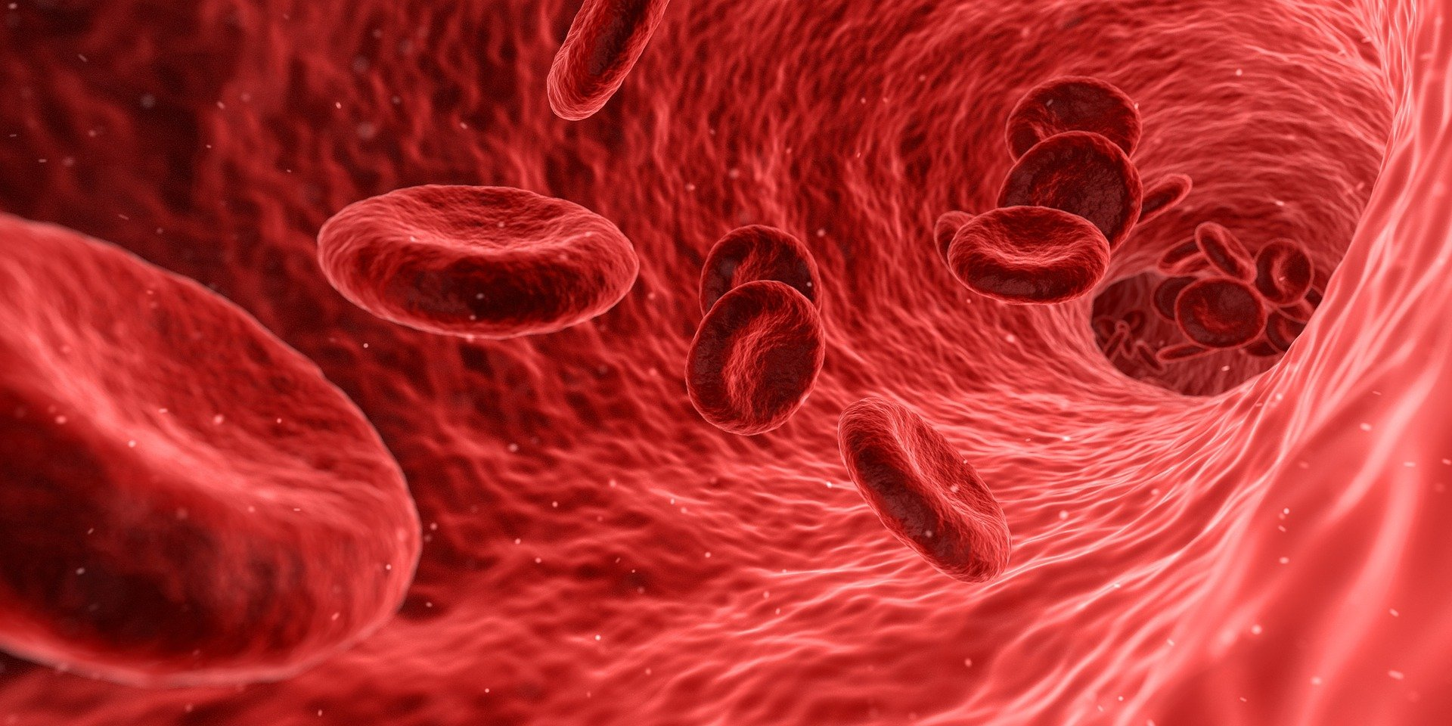

Project Modules
Admin Panel
Donor request
Search for Donor
Donor Registration
Data Flow Diagram

Slide 6
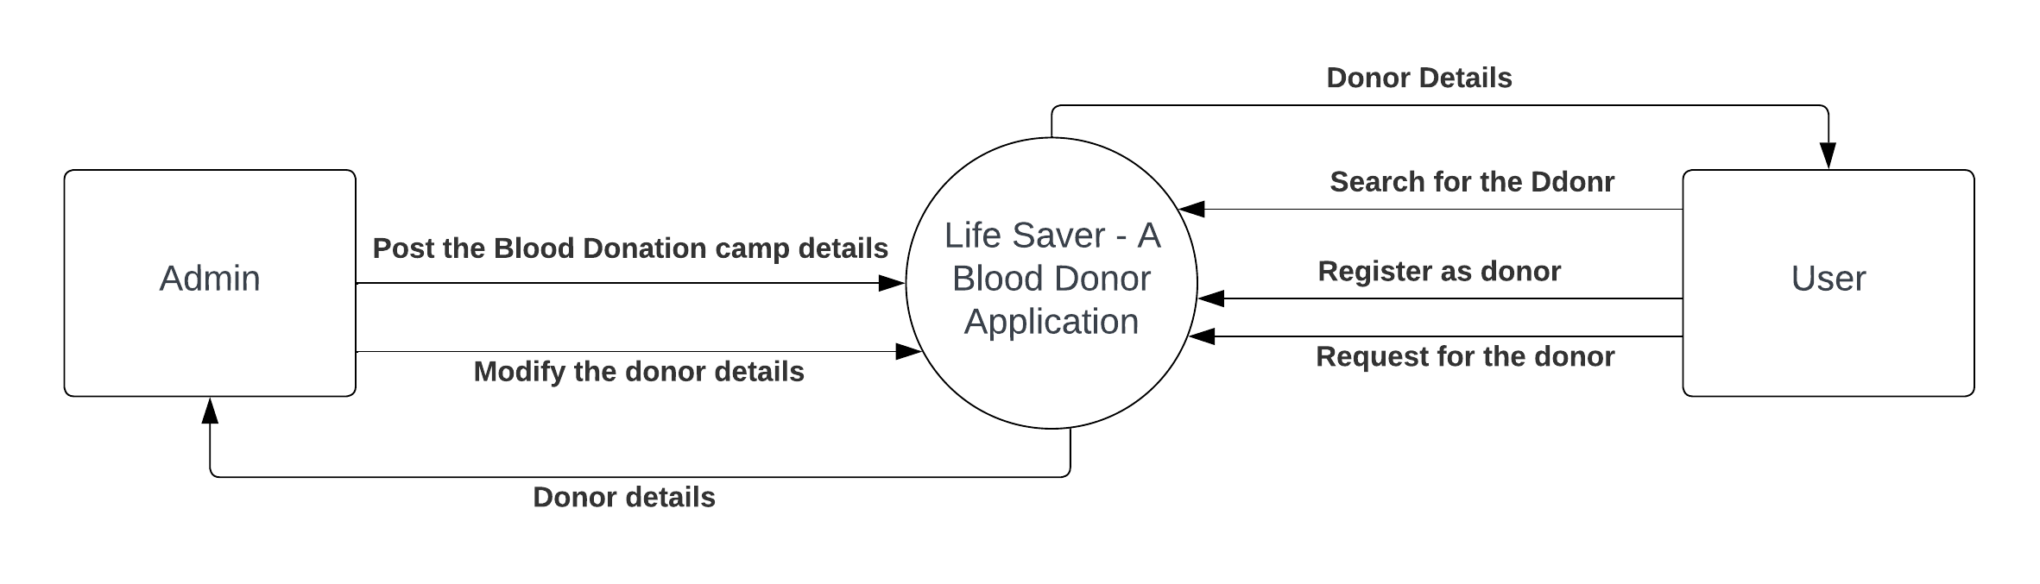
Data Flow Diagram

Slide 7
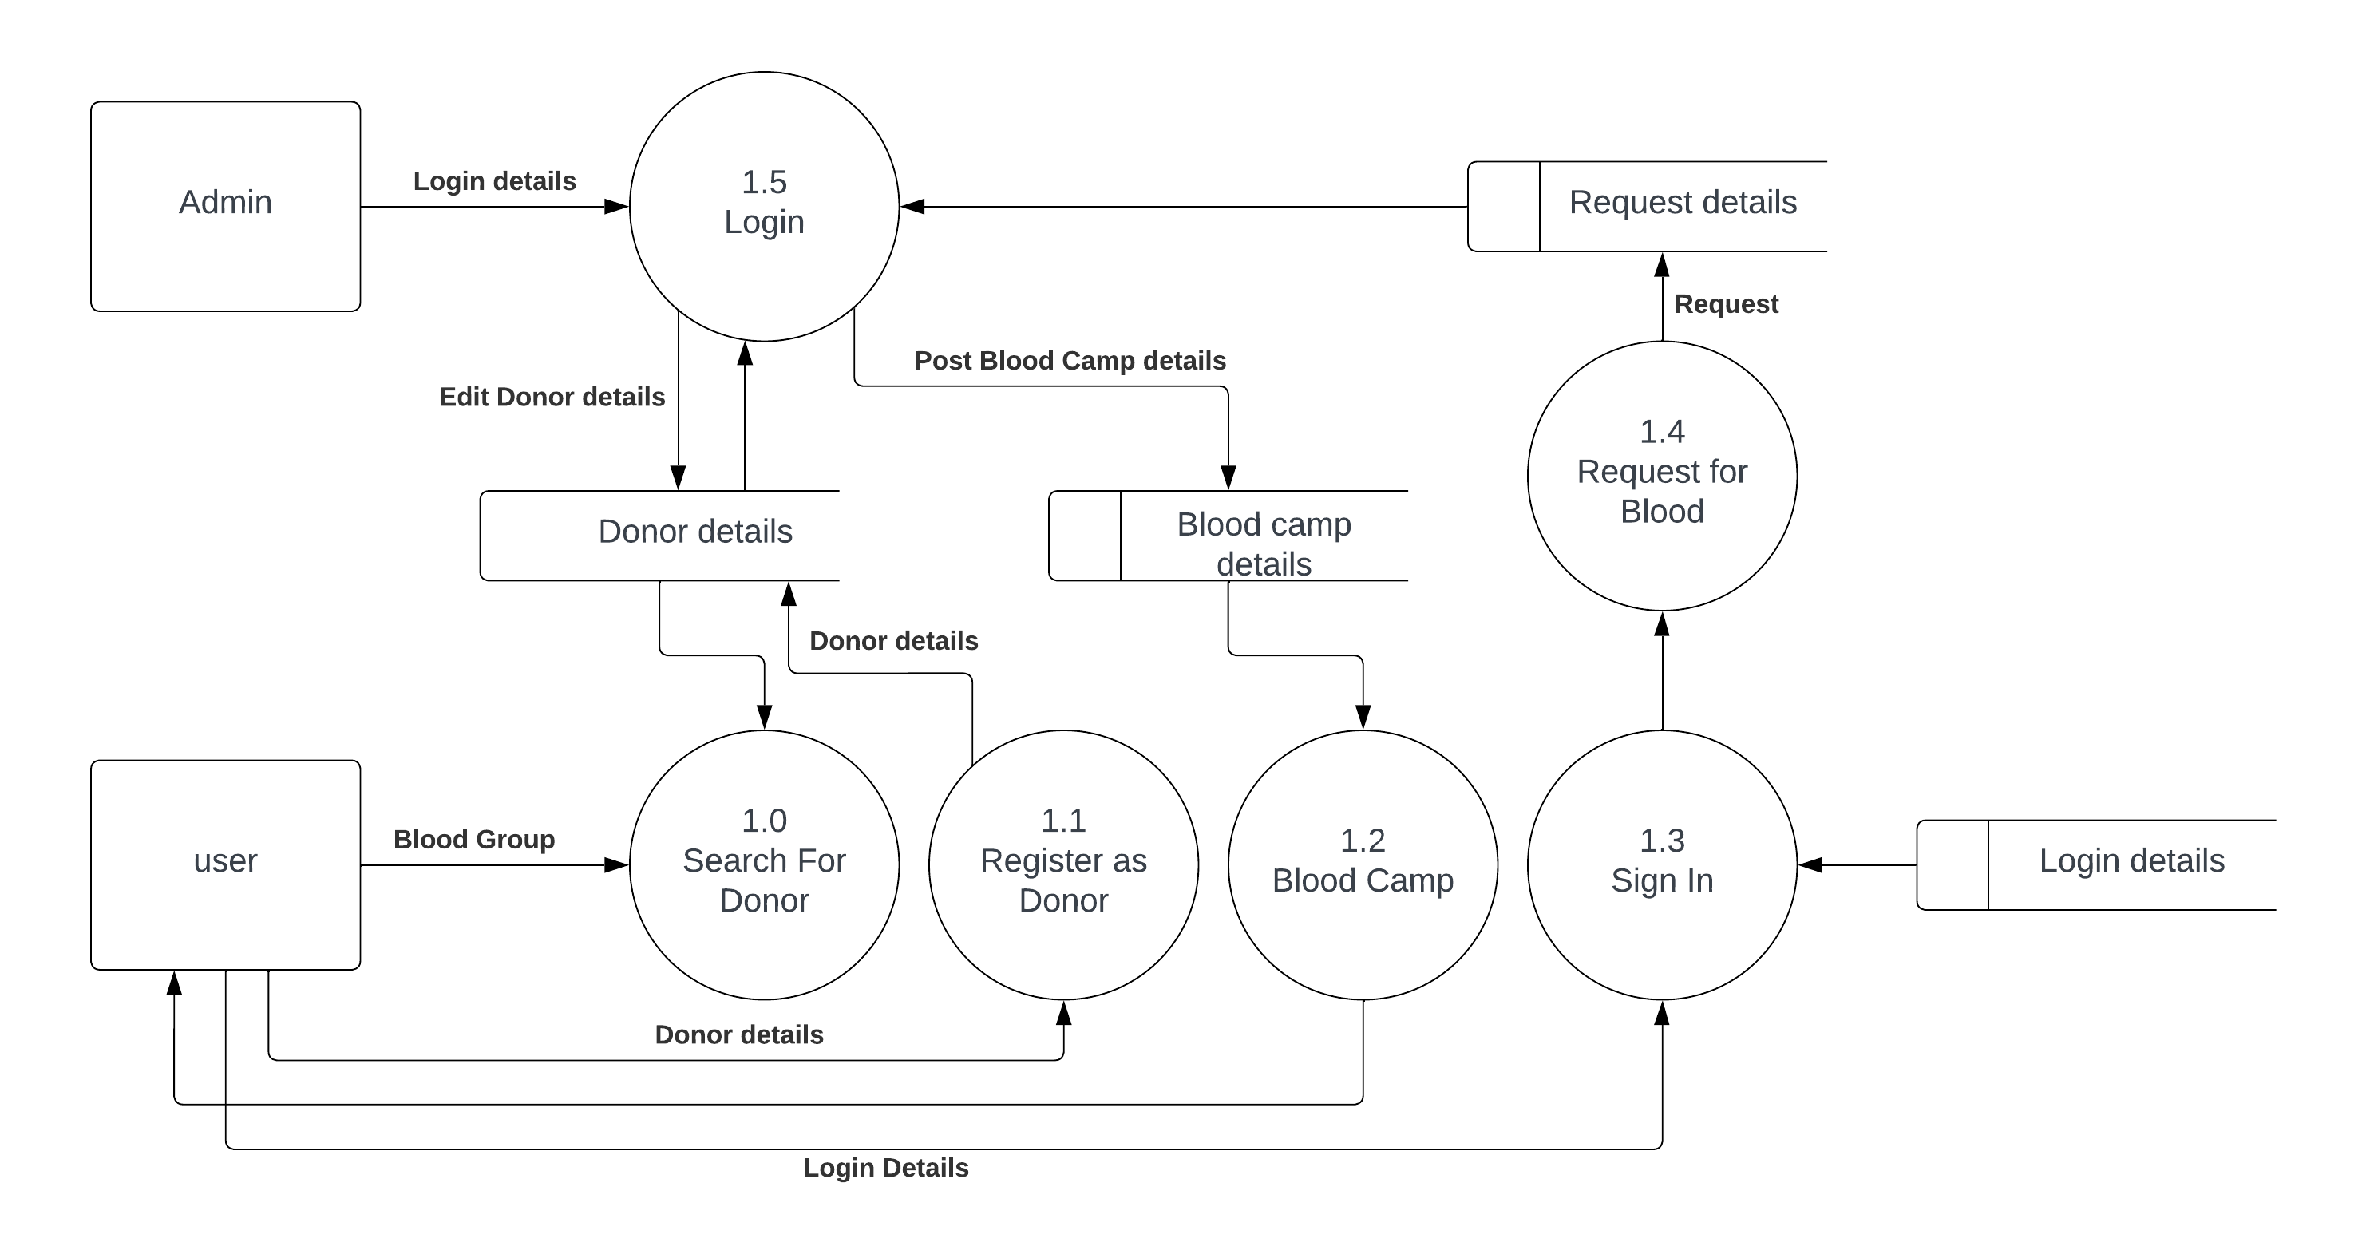
level – 0 (Abstract Level)

Slide 8
level – 1

Slide 9


Summary
In fact, every two seconds of every day, someone needs blood. Since blood cannot be manufactured outside the body and has a limited shelf life, the supply must constantly be replenished by generous blood donors.

Slide 10
Team Members
Dhanaselvan J U
Aagash G
Jaswath K

Slide 11




Thank you

